Slide 2
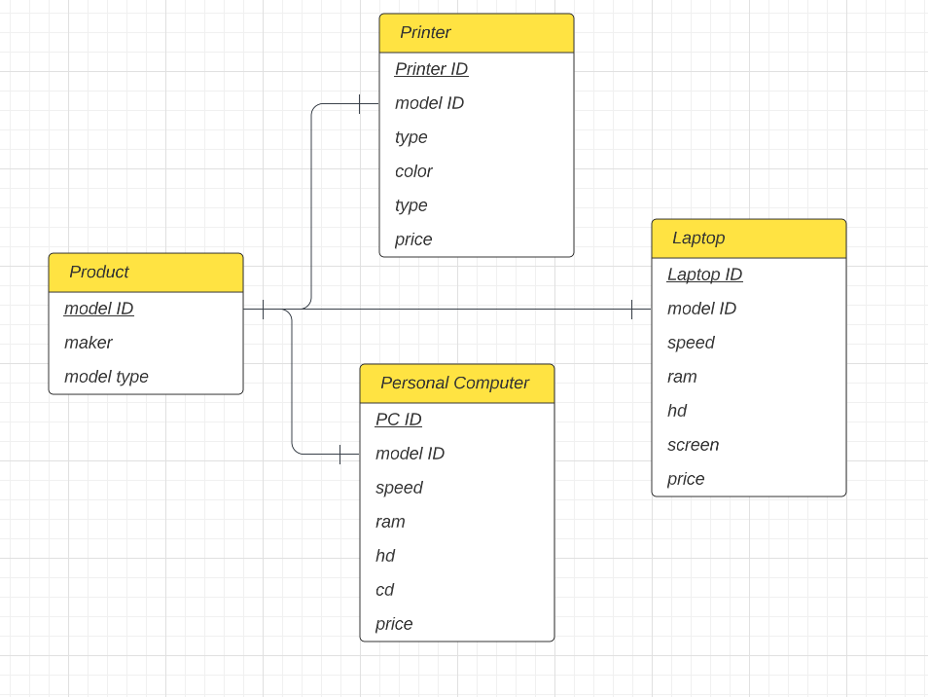
Entity Relationship Diagram

Slide 3
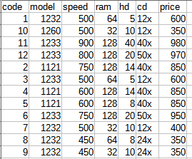
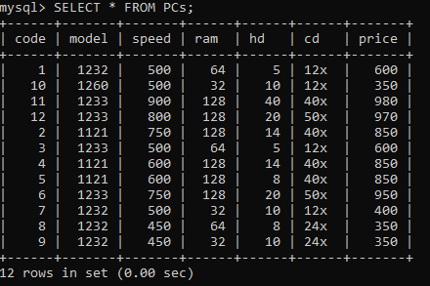
Setup in MySQL
As a test environment the example data was imported into a MySQL server. Converted from the csv format.

Slide 4
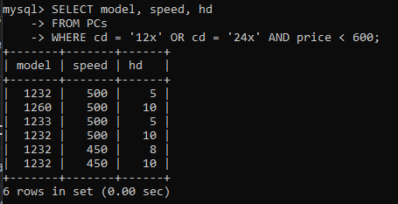
Find the model number, speed, and hard drive size of PCs with a 12x or 24x CD drive
SELECT model, speed, hd
FROM PCs
WHERE cd = ‘12x’ OR cd = ‘24x’ AND price < 600

Slide 5
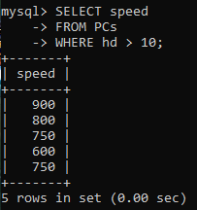
Find the processing speed of each manufacturer of laptops with a hard drive capacity of at least 10 GB.
SELECT speed
FROM PCs
WHERE hd > 10

Slide 6
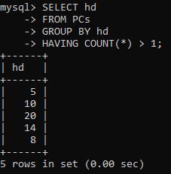
Find hard drive capacities that are identical for two or more computers
SELECT hd
FROM PCs
GROUP BY hd
HAVING COUNT(*) > 1;

